Slide 1

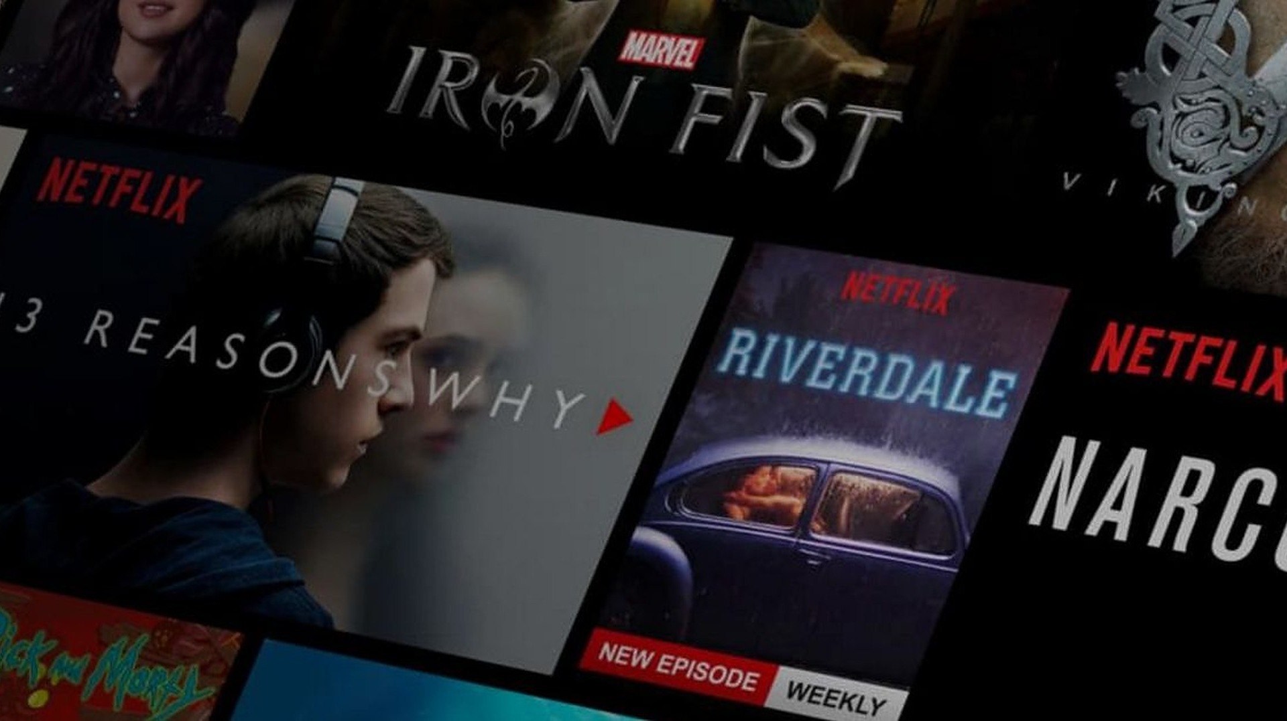




5th August 2021
Movies Recommender System
Anwesh Praharaj
UCF : 5366796
STA6704

Slide 2

Outline
Introduction
Dataset & Statistical Analysis
Algorithm
Results
Future Work

Slide 3

Introduction
A recommender system (RS) helps user’s life easy by recommending items
Offering news articles to on-line newspaper readers, based on a prediction of reader interests.
Offering customers of an on-line retailer suggestions about what they might like to buy, based on their history of purchases and/or product searches.
Recommending movies to user based on there previous watch
Recommendation of parts replace/repair in homeowner insurance company

Slide 4

Statistical analysis

Slide 5
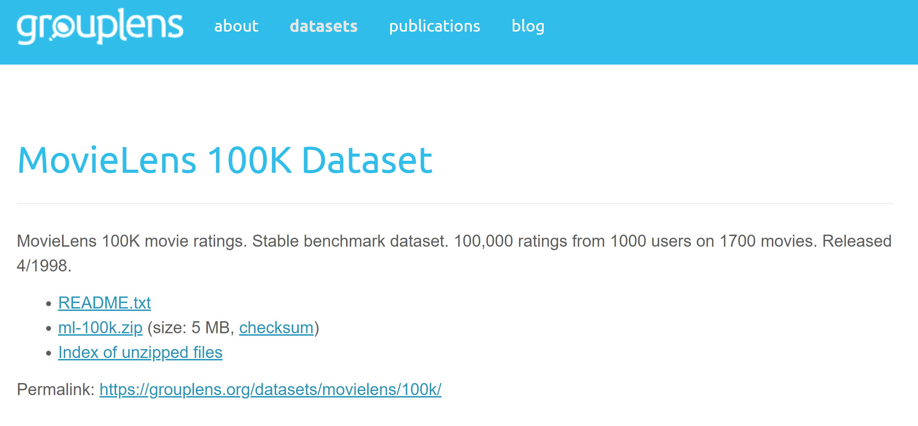
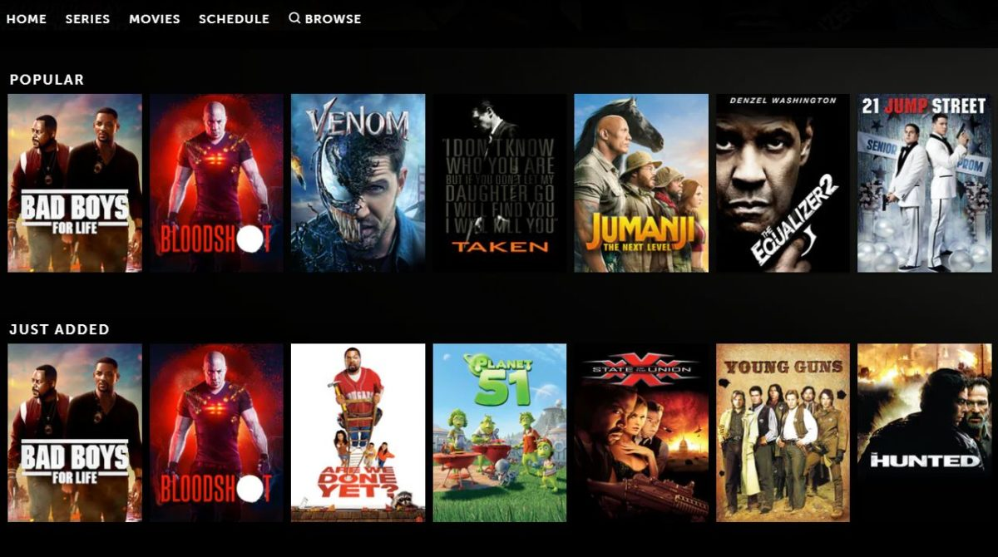
Dataset
MovieLens provided data related to users , Movies and rating of each movie by users
In our recommendation system we are using this rating and item dataset
dataset Link: https://grouplens.org/datasets/movielens/100k/

Slide 6
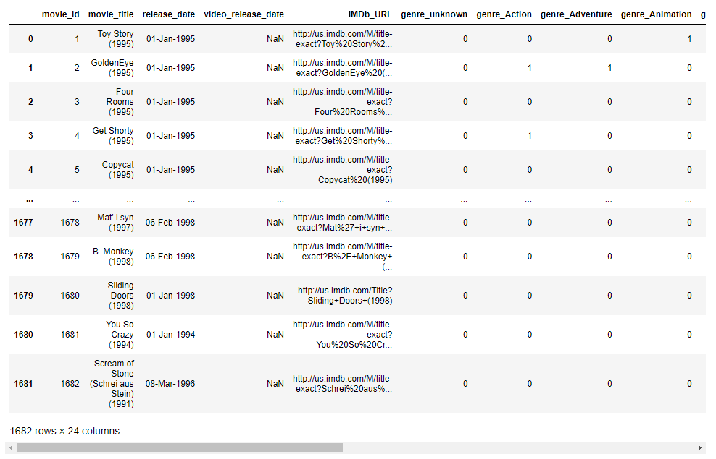
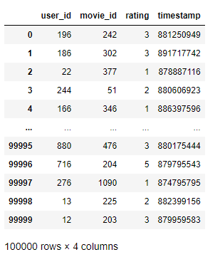
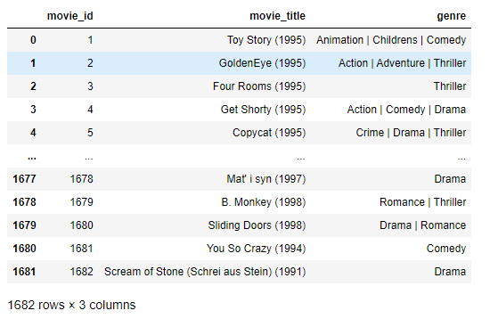
Dataset
u.item
u.data

Slide 7
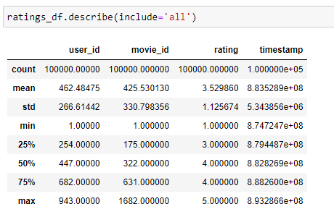
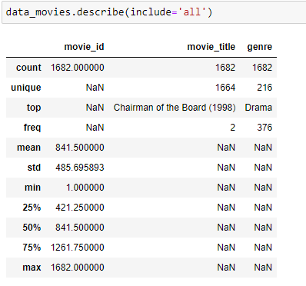
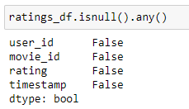
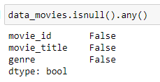
Statistical Analysis & EDA
Descriptive statistics
Missing Values

Slide 8
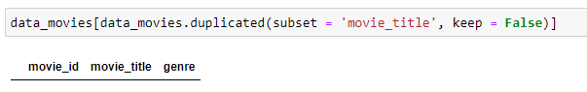
Duplicate Entries
Deleting

Slide 9
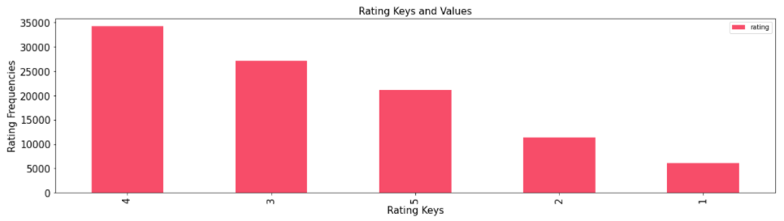
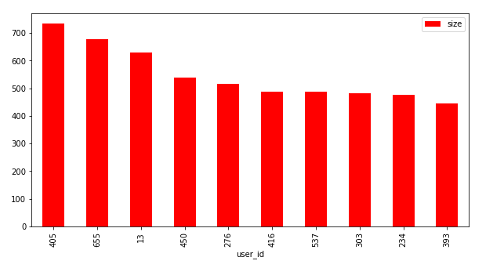
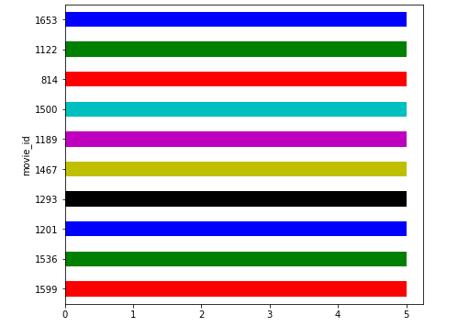
Rating counts
Top 10 users who have rated most of the movies
Movies with High Rating

Slide 10
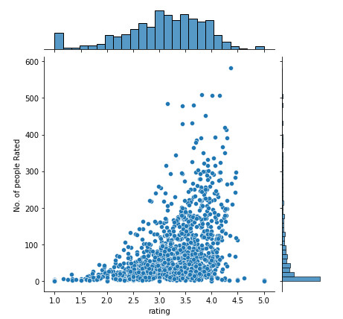
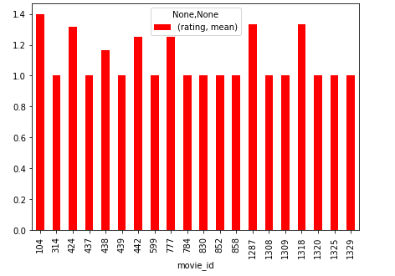
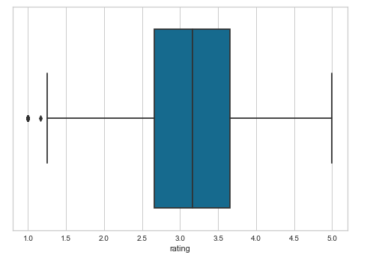
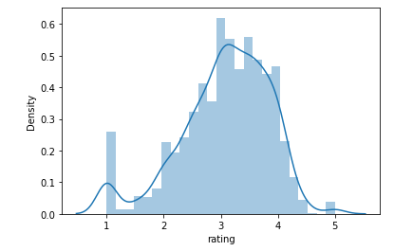
Movies with low average rating
Rating Density Range

Slide 11

Algorithm Methods

Slide 12
User-Item
Filtering
Memory Based
Item-Item
Filtering
Collaborative Filtering
Matrix factorization
Model Based
Clustering
Content-based Filtering
Term Frequency (TF)
Inverse Document Frequency (IDF)
Word Cloud

Slide 13



Content-based filtering
Collaborative Filtering
rated / watched by both user
Already rated / watched
Similar User
U1
U2
Similar Movies
Recommended to user
Rated by User 1
Recommended to User 2

Slide 14
Content-based filtering

Slide 15
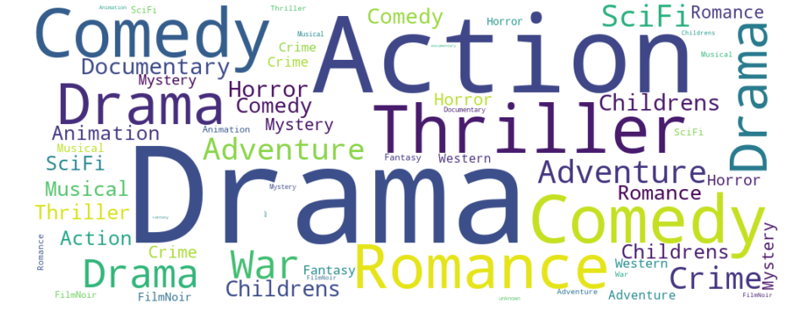
Content-based Filtering
Identifying movies that are similar to the movies you like
To find popular movie used World Cloud library

Slide 16
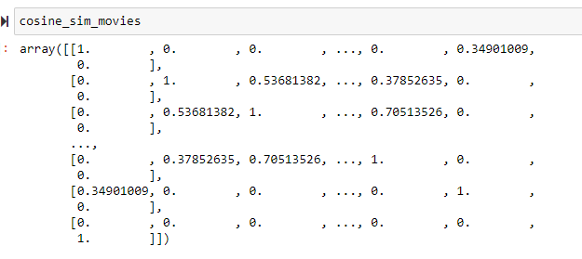
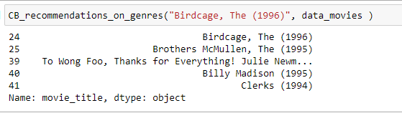
Convert a collection of raw documents to a matrix of TF-IDF features
Use cosine similarity to get the proximity measure
Recommendation based on genres

Slide 17
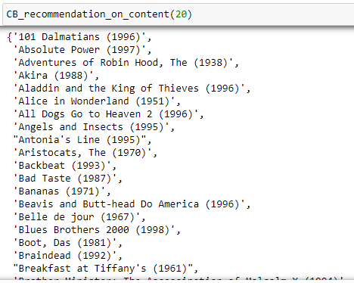
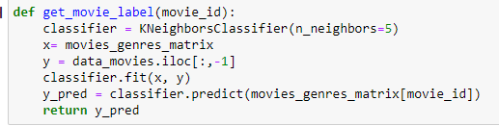
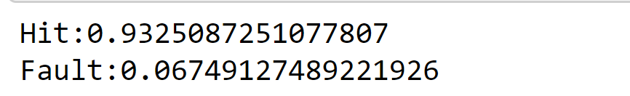
Recommendation based on Rating
Model Evaluation ( Knn Classifier )

Slide 18
Disadvantages :
Can not filter items on some assessment because of lack of
other users experience
Absence of personal recommendation

Slide 19

Collaborative filtering

Slide 20
Collaborative Filtering
Based on shared interests
Memory-based uses user’s rating data to compute the similarity between user and Movie
User-Item Filtering
Item-Item Filtering
Rating patterns between user
Item-item matrix of rating relationship

Slide 21
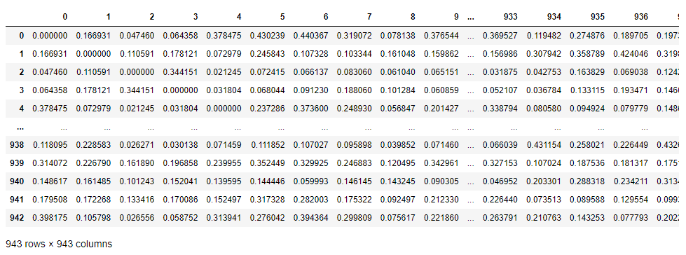
User – Item Filtering
Created a rating matrix between user in each row and movie in each column
Find Cosine pairwise distance ( columns are vector and rows as Users)

Slide 22
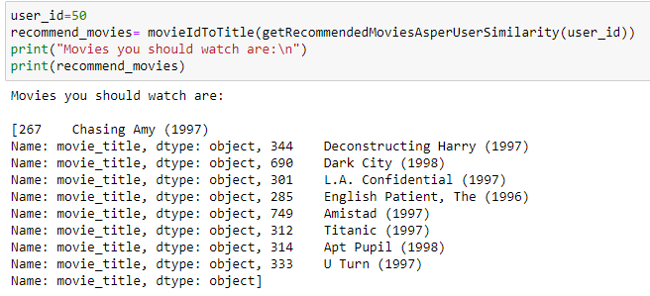
Use-case
Results
There are two users U1 and U2
U1 watched two movie M1 and M2
U2 watched one movie M1
This method computes similarity of two users and find
any common watched movie.
Disadvantages
This algorithm has high time complexity as it compare and finding similarity between Matrix users.
User can change there like and habit

Slide 23
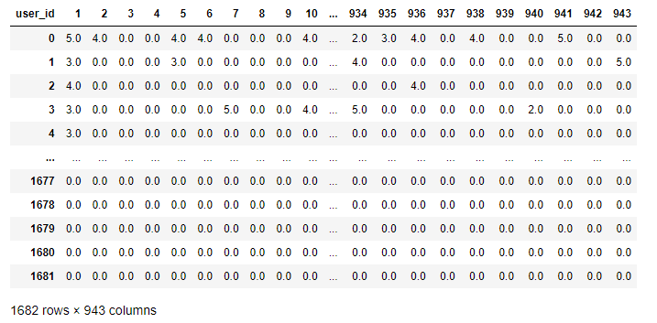
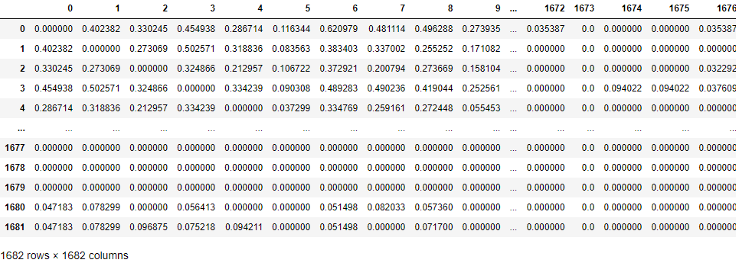
Item – Item Filtering
Created a rating matrix between user in each row and movie in each column
Find Cosine pairwise distance ( rows are vector and columns are Movies)

Slide 24

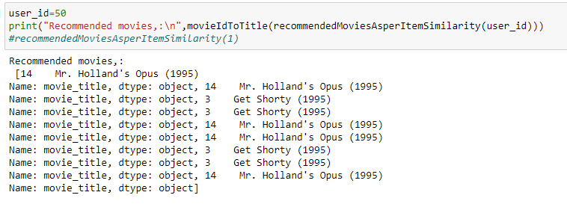

Use-case
Similarity between M1 and M2 is based on
How many common users liked both.
If similarity is high, then we can recommend
M1 to user who did not watch it
Results
This Photo by Unknown Author is licensed under CC BY
This Photo by Unknown Author is licensed under CC BY-NC-ND

Slide 25
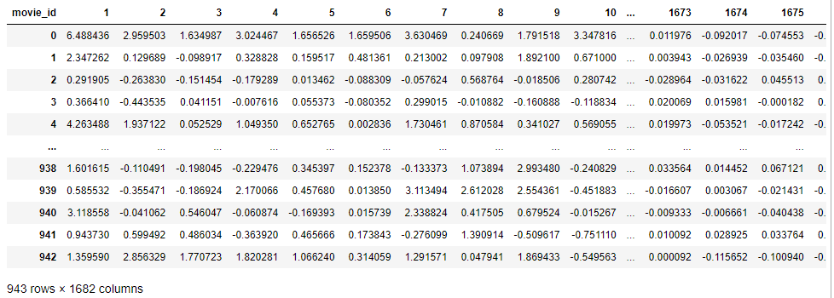
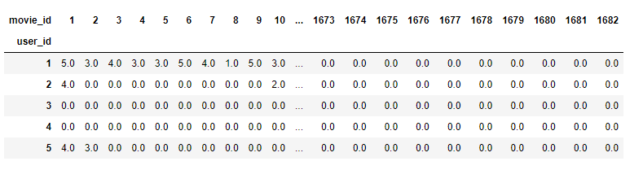
Matrix Factorization
This is used for Dimensionality Reduction
After decomposition will get U and M matrix with non-empty cell
Dot product of U and M
U
M
U
d
d
M

Slide 26
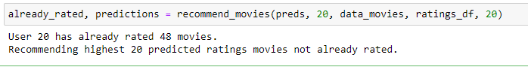
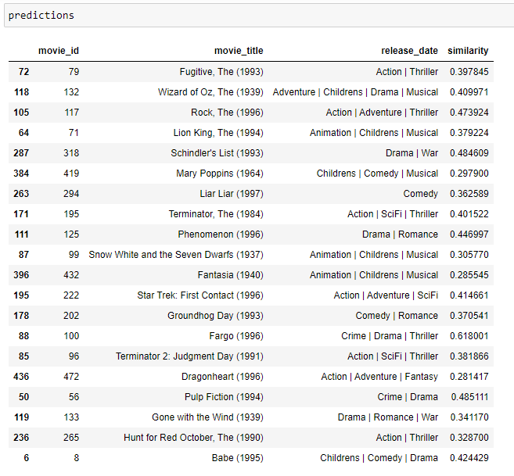
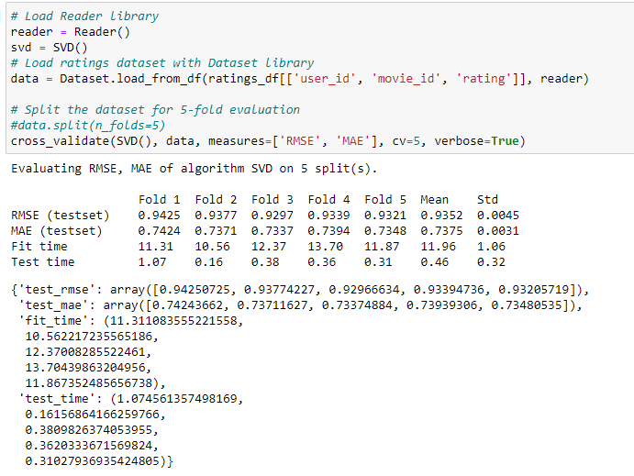
Output
Model Evaluation SVD:

Slide 27
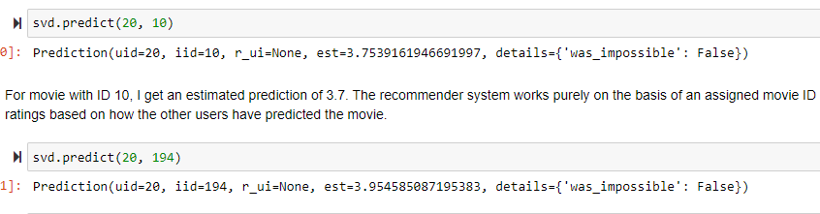
Prediction of User rating for a user and Movie

Slide 28
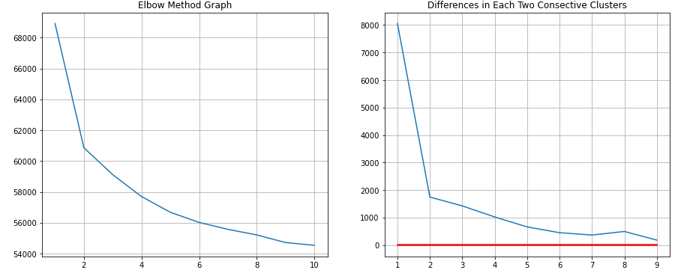
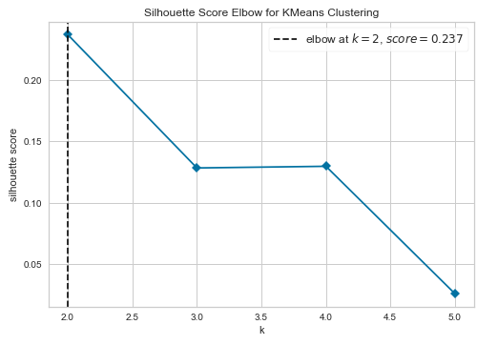
Clustering
Clustering is the process of grouping similar item or users in a specific group
Considered the Rating more than 3
Created a sparse matrix
Use elbow method to find the appropriate cluster

Slide 29
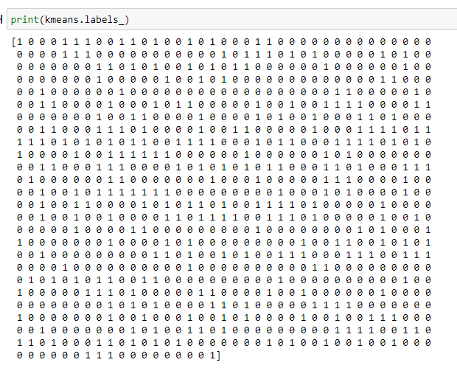
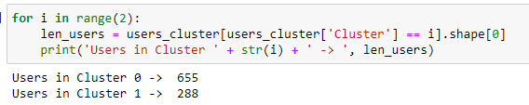

Slide 30
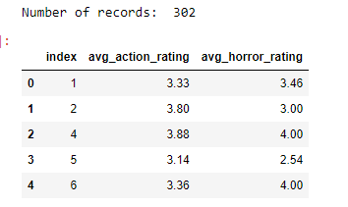
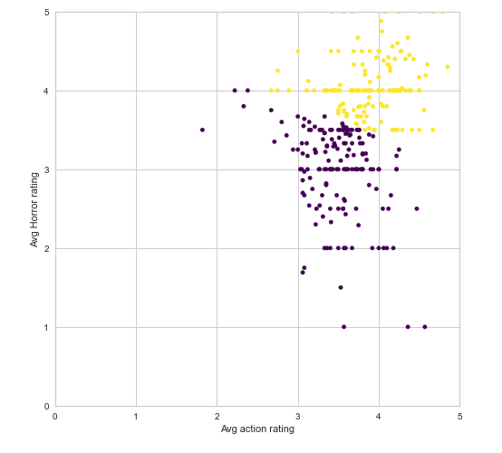
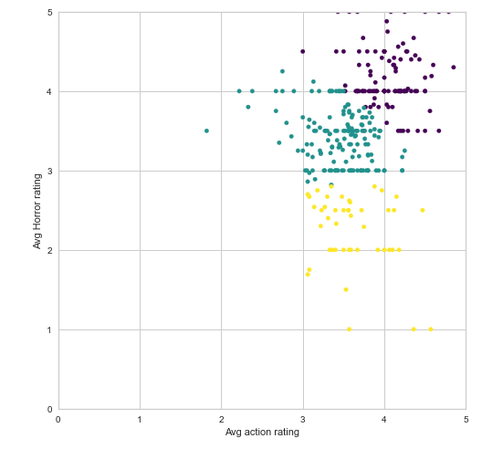
Case 1. Consider two movie type find user group
Which Subset of users rated most Action and Horror movie
Find average action rating and avg horror rating
2 cluster
3 cluster

Slide 31
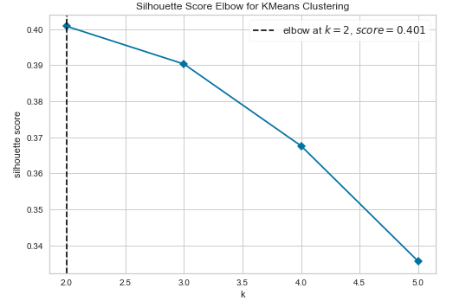
Appropriate cluster should be 2

Slide 32
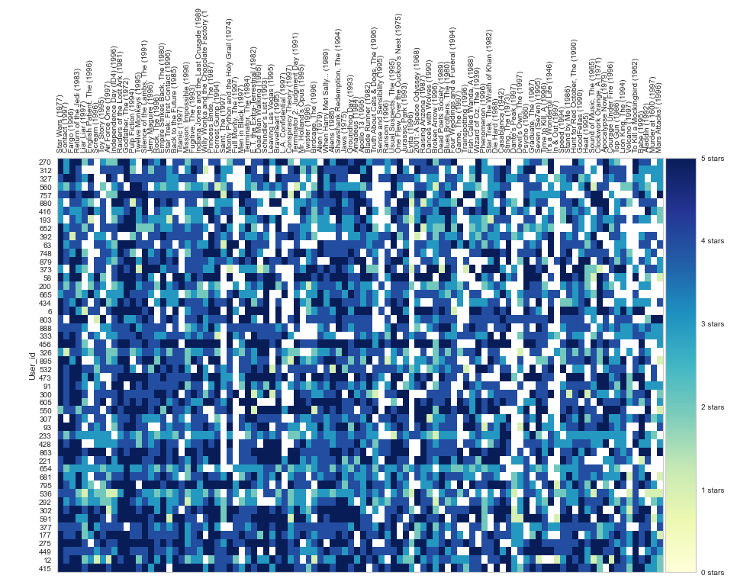
Case 2. User rated most in a cluster
For visualization purpose only selected 100 movies and 50 users

Slide 33
Disadvantages :
Cold Start : There should be enough user in system
Sparsity : Rating missing for most of the user
Never rated : Not possible to recommend if never rated

Slide 34

Future work
Use Hybrid algorithm ( Content + collaborative )
Use Deep learning techniques

